Slide 1
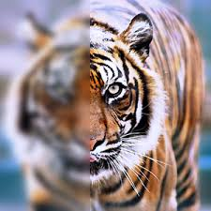
Image Restoration
By Samartha K
Reg.No : 21ETIS411005

Slide 2
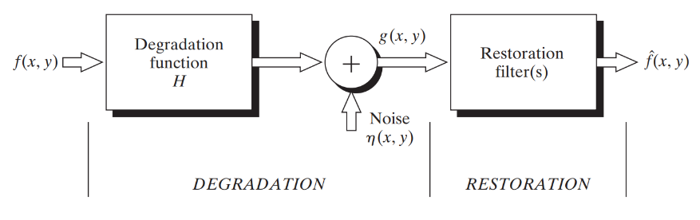
Degradation/Restoration Process

Slide 3
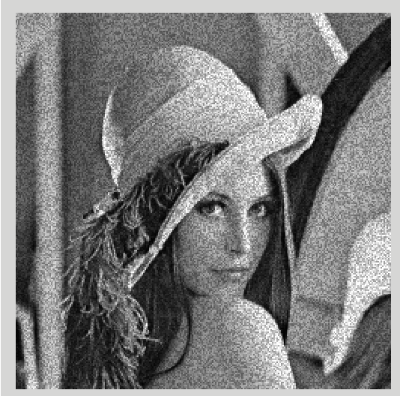
Noise Model
Gaussian Noise
Rayleigh Noise
Erlang (Gamma) Noise
Exponential Noise
Uniform Noise
Impulse (Salt-and-Pepper) Noise

Slide 4
Gaussian Noise & Salt-and-Pepper Noise
Gaussian Noise - Statistical noise with a probability density function (PDF) equal to that of the normal distribution, which is also known as the Gaussian distribution
Characteristics - It appears as random variations in intensity The noise is spread evenly across the image
Source - Often caused by natural sources like thermal vibrations in electronic devices, sensor noise, or poor illumination during image acquisition
Appearance - It looks like fine grain across the entire image, with small, random variations in pixel values
Salt-and-Pepper Noise - Characterized by random occurrences of black and white pixels
Characteristics - It typically consists of only two possible values: one representing white (salt) and the other black (pepper). This noise type appears as sparsely occurring white and black dots.
Source - Commonly caused by sharp and sudden disturbances like faulty switches, bit errors in transmission, or malfunctioning pixel elements in camera sensors.
Appearance - It looks like scattered black and white specks over the image, often making it look like the image has been sprinkled with salt and pepper.
Notes:
Gaussian Noise:
Description: Gaussian noise is a type of statistical noise with a probability density function (PDF) equal to that of the normal distribution, which is also known as the Gaussian distribution.
Characteristics: It appears as random variations in intensity, with most variations being small and a few being larger. The noise is spread evenly across the image.
Source: Often caused by natural sources like thermal vibrations in electronic devices, sensor noise, or poor illumination during image acquisition.
Appearance: It looks like fine grain across the entire image, with small, random variations in pixel values.
Salt-and-Pepper Noise:
Description: Salt-and-pepper noise, also known as impulse noise, is characterized by random occurrences of black and white pixels.
Characteristics: It typically consists of only two possible values: one representing white (salt) and the other black (pepper). This noise type appears as sparsely occurring white and black dots.
Source: Commonly caused by sharp and sudden disturbances like faulty switches, bit errors in transmission, or malfunctioning pixel elements in camera sensors.
Appearance: It looks like scattered black and white specks over the image, often making it look like the image has been sprinkled with salt and pepper.
Gaussian Noise:
Description: Gaussian noise is a type of statistical noise with a probability density function (PDF) equal to that of the normal distribution, which is also known as the Gaussian distribution.
Characteristics: It appears as random variations in intensity, with most variations being small and a few being larger. The noise is spread evenly across the image.
Source: Often caused by natural sources like thermal vibrations in electronic devices, sensor noise, or poor illumination during image acquisition.
Appearance: It looks like fine grain across the entire image, with small, random variations in pixel values.
Salt-and-Pepper Noise:
Description: Salt-and-pepper noise, also known as impulse noise, is characterized by random occurrences of black and white pixels.
Characteristics: It typically consists of only two possible values: one representing white (salt) and the other black (pepper). This noise type appears as sparsely occurring white and black dots.
Source: Commonly caused by sharp and sudden disturbances like faulty switches, bit errors in transmission, or malfunctioning pixel elements in camera sensors.
Appearance: It looks like scattered black and white specks over the image, often making it look like the image has been sprinkled with salt and pepper.

Slide 5
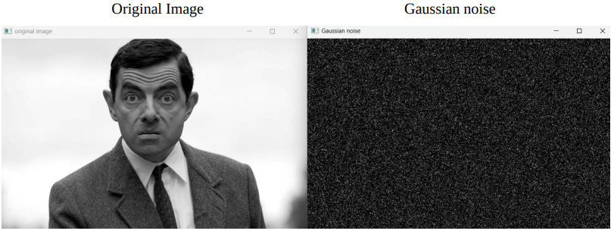
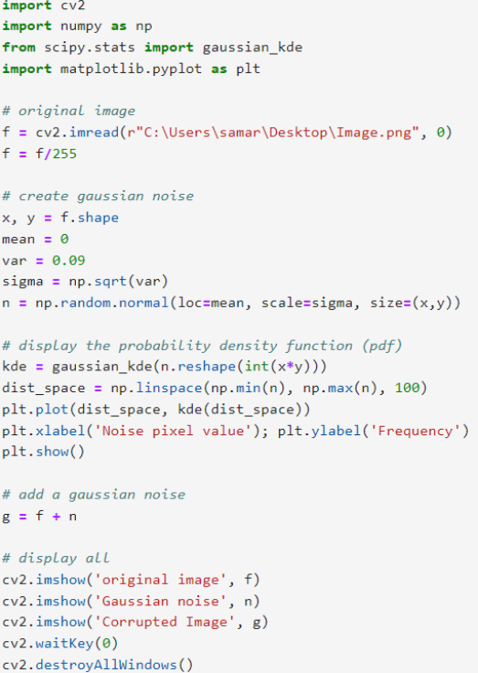
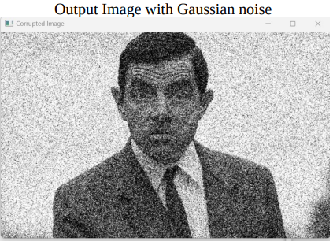
Implementation
Gaussian Noise

Slide 6
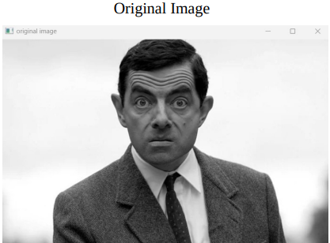
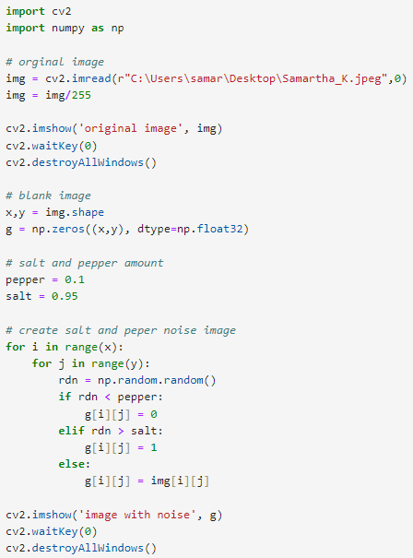
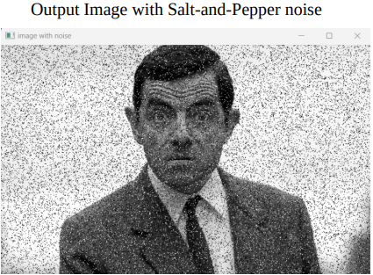
Implementation
Salt-and-Pepper Noise

Slide 7
Filtering Technique
Mean Filters
Order-Statistics Filters
Adaptive Filters
Periodic Noise Reduction by Frequency Domain Filtering

Slide 8
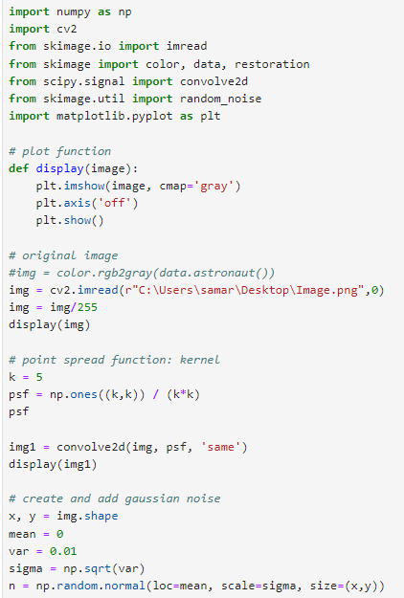
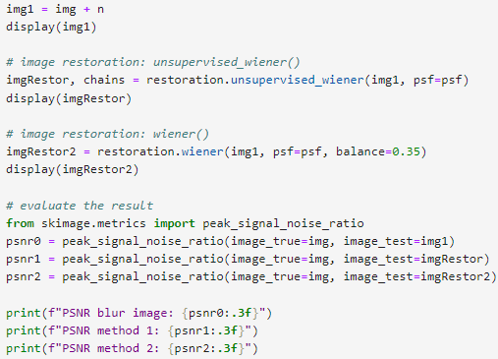
Wiener Filter Implementation

Slide 9
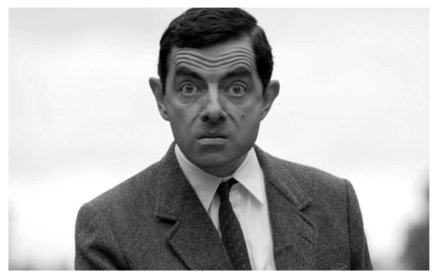

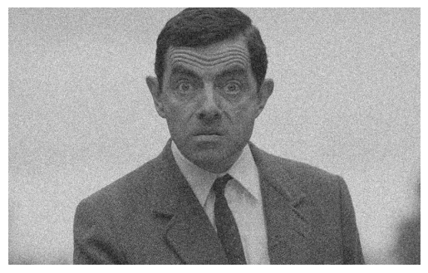
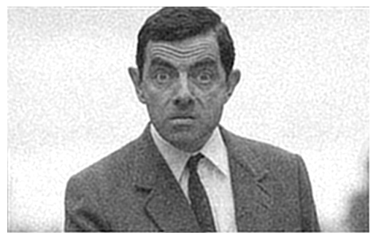

Wiener Filter Implementation
Original Image
Image with Blur
Image with Gaussian Noise
Restored Image
Partially Restored Image
Wiener
Filtering

Slide 10

Applications

